Slide 1

Azure Cognitive Search Beyond the First Demo
Marco Minerva
Microsoft MVP Windows Development https://about.me/marcominerva

Slide 2






Azure Cognitive Search Pipeline
Data
Source
Enriched
Documents
Ingest Enrich Explore
Any Data format
Any Azure Store
Cognitive Skills
Azure Search API
Portal

Slide 3
THE FIRST DEMO

Slide 4
Incremental indexing with SQL Server
SQL Integrated Change Tracking Policy (recommended)
Detect new, changed and deleted rows
There are some requirements
High Water Mark Change Detection Policy
Using a rowversion column
Detect new and changed rows
Deleted rows need a “soft delete” approach
Notes:
Requirements for SQL Integrated Change Tracking Policy
Database version requirements:
SQL Server 2012 SP3 and later, if you're using SQL Server on Azure VMs.
Azure SQL Database V12, if you're using Azure SQL Database.
Tables only (no views).
On the database, enable change tracking for the table.
No composite primary key (a primary key containing more than one column) on the table.
For the deletes to be detected "automagically", the document key in your search index must be the same as the primary key in the SQL table.
When using TRUNCATE TABLE to remove a large number of rows from a SQL table, the indexer needs to be reset to reset the change tracking state to pick up row deletions.
Requirements for High Water Mark Change Detection Policy
All inserts specify a value for the column.
All updates to an item also change the value of the column.
The value of this column increases with each insert or update.
Queries with the following WHERE and ORDER BY clauses can be executed efficiently: WHERE [High Water Mark Column] > [Current High Water Mark Value] ORDER BY [High Water Mark Column]

Slide 5
Incremental indexing with Azure Storage
New blobs are automatically indexed
Changed blobs are reindexed according to their LastModified timestamp
Deleted blobs aren’t handled by default
Soft delete on Blob Storage must be enabled

Slide 6
DEMO

Slide 7
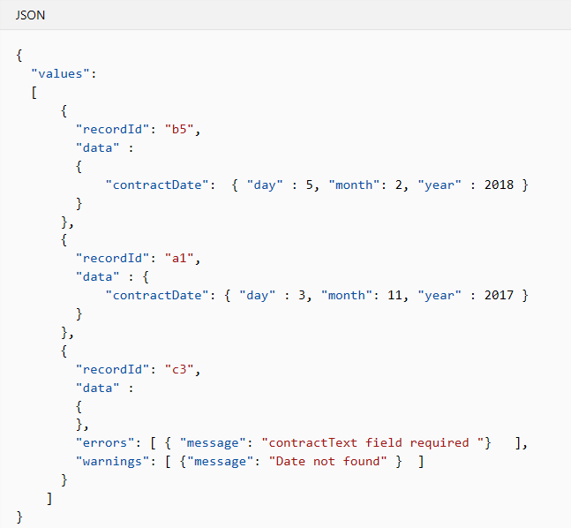
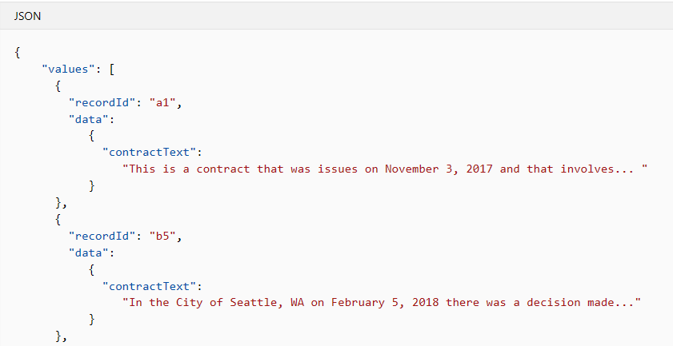
Extending Azure Cognitive Search
We can add custom skills to the enrichment pipeline
Microsoft.Skills.Custom.WebApiSkill allows to extend Cognitive Search by calling a Web API endpoint
We can use our AI models and perform operations to enrich documents
OUTPUT
INPUT
Notes:
Building a custom skill gives you a way to insert transformations unique to your content. A custom skill executes independently, applying whatever enrichment step you require.

Slide 8
DEMO

Slide 9
Scoring profile
The score is an indicator of an item's relevance in the context of the search
By default, the score is computed based on statistical properties of the data and the query
Term frequency-inverse document frequency (TF-IDF)
We can create our scoring profiles

Slide 10
DEMO

Slide 11
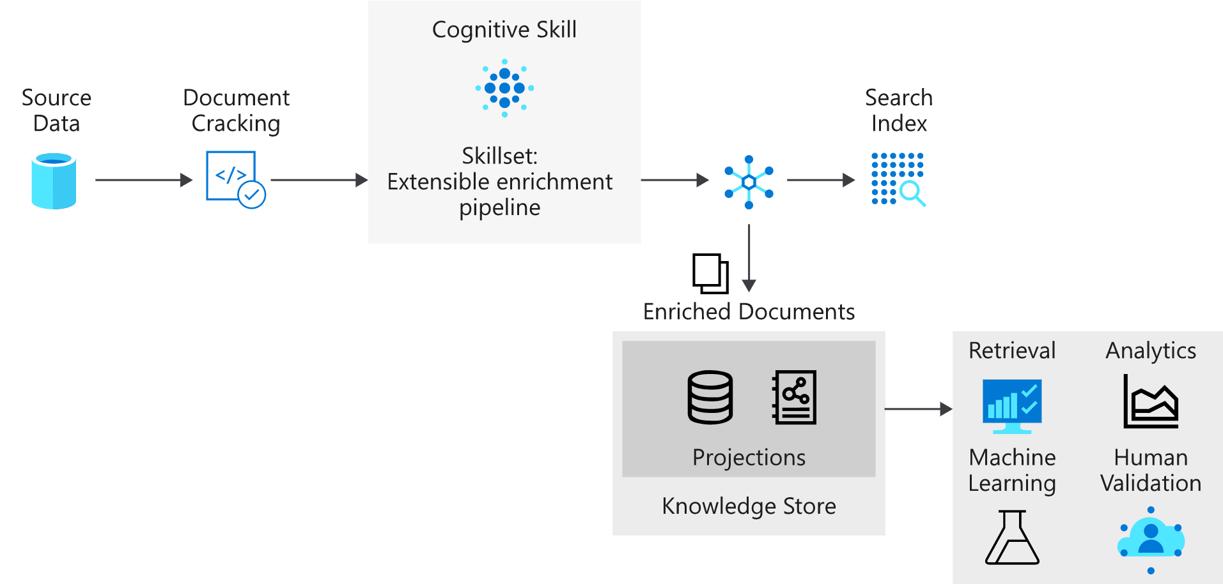
Knowledge store
Persists output from an AI enrichment pipeline for independent analysis or downstream processing
Saved on Azure Storage
Notes:
An enriched document is a pipeline's output, created from content that has been extracted, structured, and analyzed using AI processes. In a standard AI pipeline, enriched documents are transitory, used only during indexing and then discarded. With knowledge store, enriched documents are preserved.

Slide 12
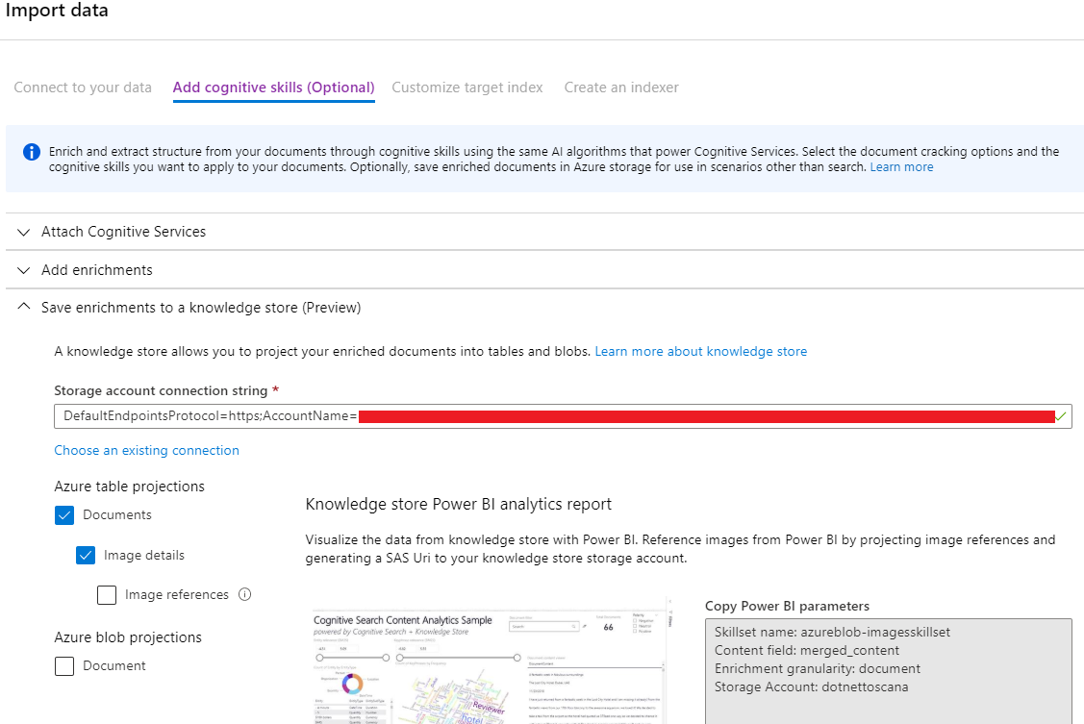
Define a Knowledge Store
Via REST API
In the Import data wizard

Slide 13
DEMO

Slide 14
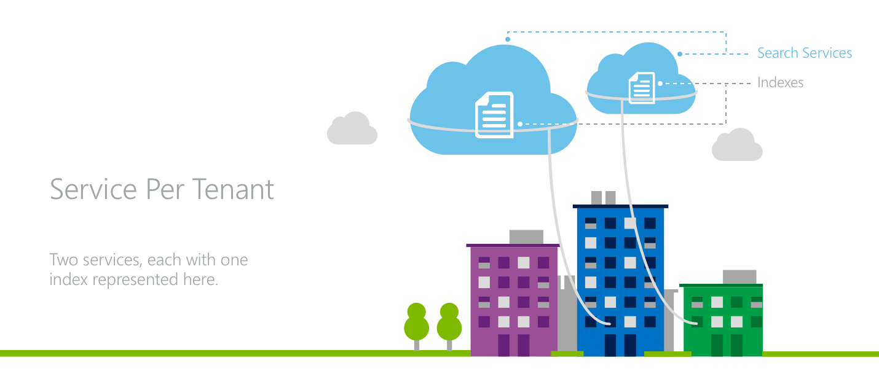
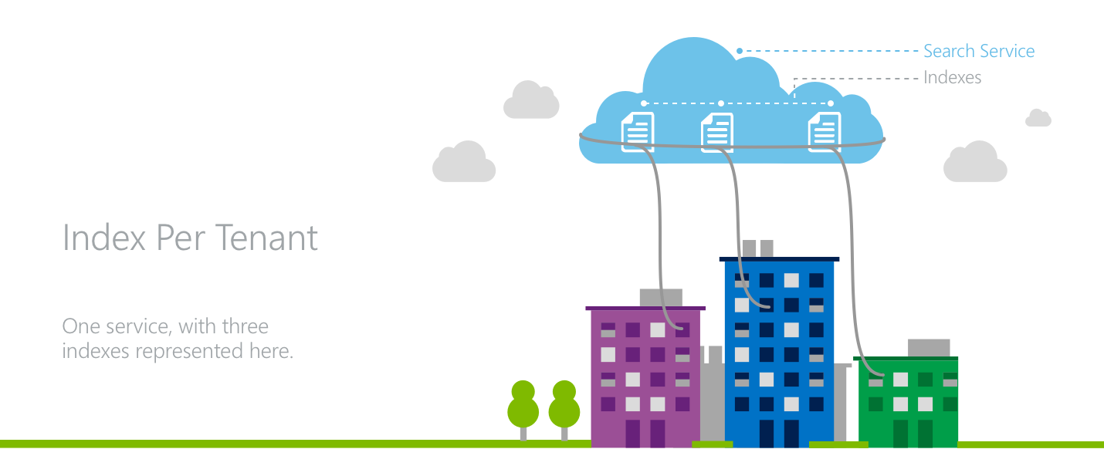
Multitenancy with Azure Cognitive Search
Index per tenant
Service per tenant
Mix of both: larger tenants with dedicated services, shared service for smaller ones
Notes:
In an index-per-tenant model, multiple tenants occupy a single Azure Cognitive Search service where each tenant has their own index.
Tenants achieve data isolation because all search requests and document operations are issued at an index level in Azure Cognitive Search. In the application layer, there is the need awareness to direct the various tenants’ traffic to the proper indexes while also managing resources at the service level across all tenants.
In a service-per-tenant architecture, each tenant has its own search service.
In this model, the application achieves the maximum level of isolation for its tenants. Each service has dedicated storage and throughput for handling search request as well as separate API keys.
For applications where each tenant has a large footprint or the workload has little variability from tenant to tenant, the service-per-tenant model is an effective choice as resources are not shared across various tenants’ workloads.

Slide 15
References
https://github.com/marcominerva/CognitiveSearch
https://docs.microsoft.com/en-us/azure/search/search-howto-connecting-azure-sql-database-to-azure-search-using-indexers
https://docs.microsoft.com/en-us/azure/search/search-howto-indexing-azure-blob-storage
https://docs.microsoft.com/en-us/azure/search/cognitive-search-custom-skill-interface
https://docs.microsoft.com/en-us/azure/search/knowledge-store-concept-intro
https://docs.microsoft.com/en-us/azure/search/search-modeling-multitenant-saas-applications

Slide 16

github.com/marcominerva
@marcominerva
linkedin.com/in/marcominerva

